Slide 1

Collaborative Business Processes
Save time gain efficiency in task completion
Streamline processes remove errors from processes
Gain skills continue to grow their skills and organizational impact
Be innovative spend their time at work utilizing their creativity
Embed logic include business rules with content
Notes:
Goal of this slide: Convey that users want to be able to do net new things that will benefit employers;
when employees are empowered to solve their own problems using Microsoft tools
- They maximize the value of a company’s investment in Microsoft technology
- They learn
- They innovate

Slide 2
Microsoft 365 manages a wide range of everyday business processes
analyzes data
and updates a key report
triggering an approval
user
scheduling a discussion
sending a notification
creating a to-do
approving an update
archiving the document
Notes:
Microsoft 365 has process management – and process automation at its roots. We take for granted the processes it replaced – editing with white-out, or literally cutting and pasting documents together. And it’s actually difficult to imagine how we managed without Excel. Did the histogram/pivot tables even exist when our grandparents were at work?
So yes, a lot has changed – dramatically.
The way we communicate.
The way we store and file information
The way we search and locate knowledge.
All transformed. But transformation never stops. And the features of product like Microsoft 365 to transform business processes are conceived at scale.

Slide 3
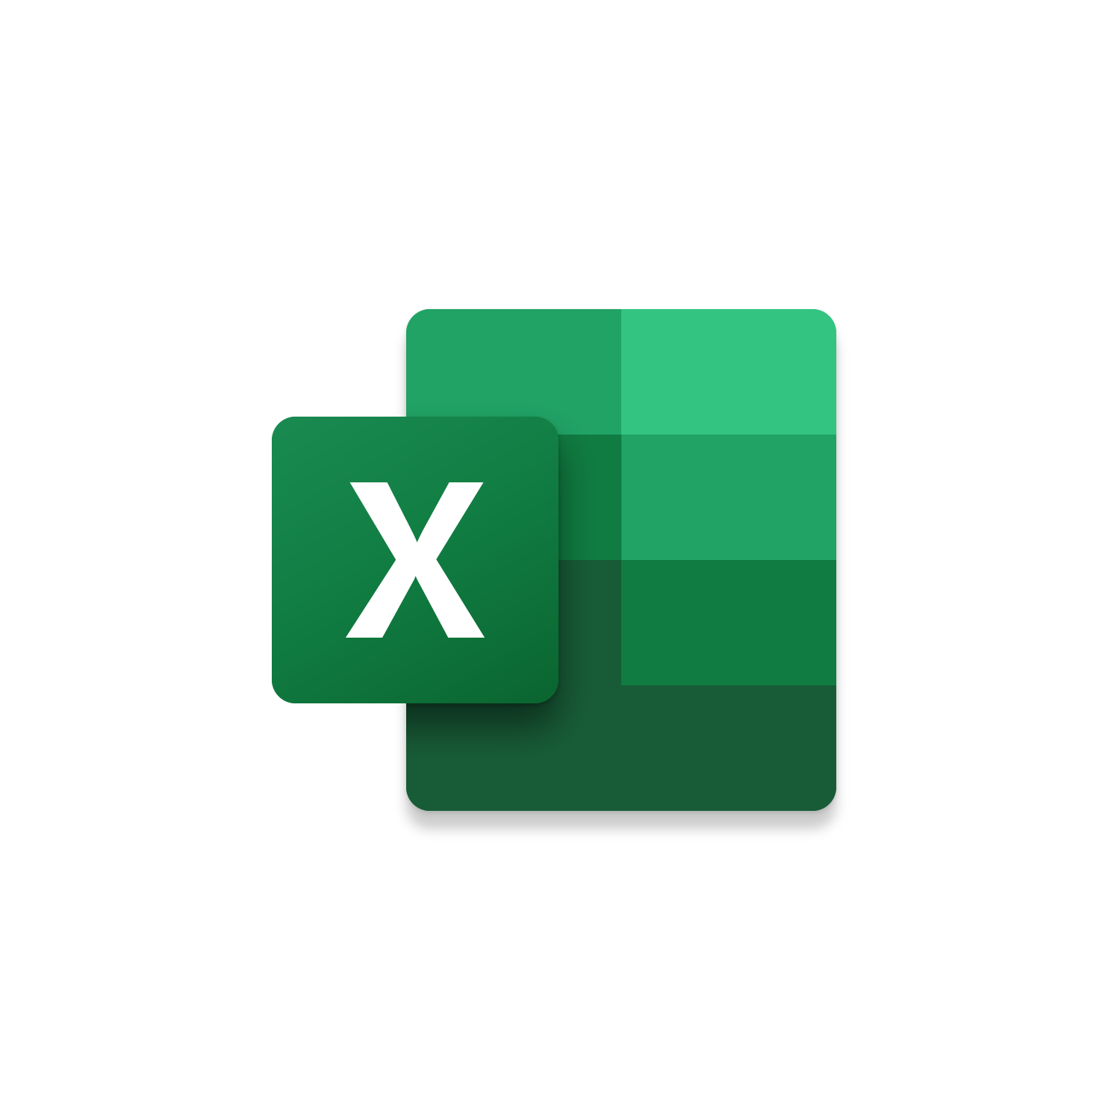
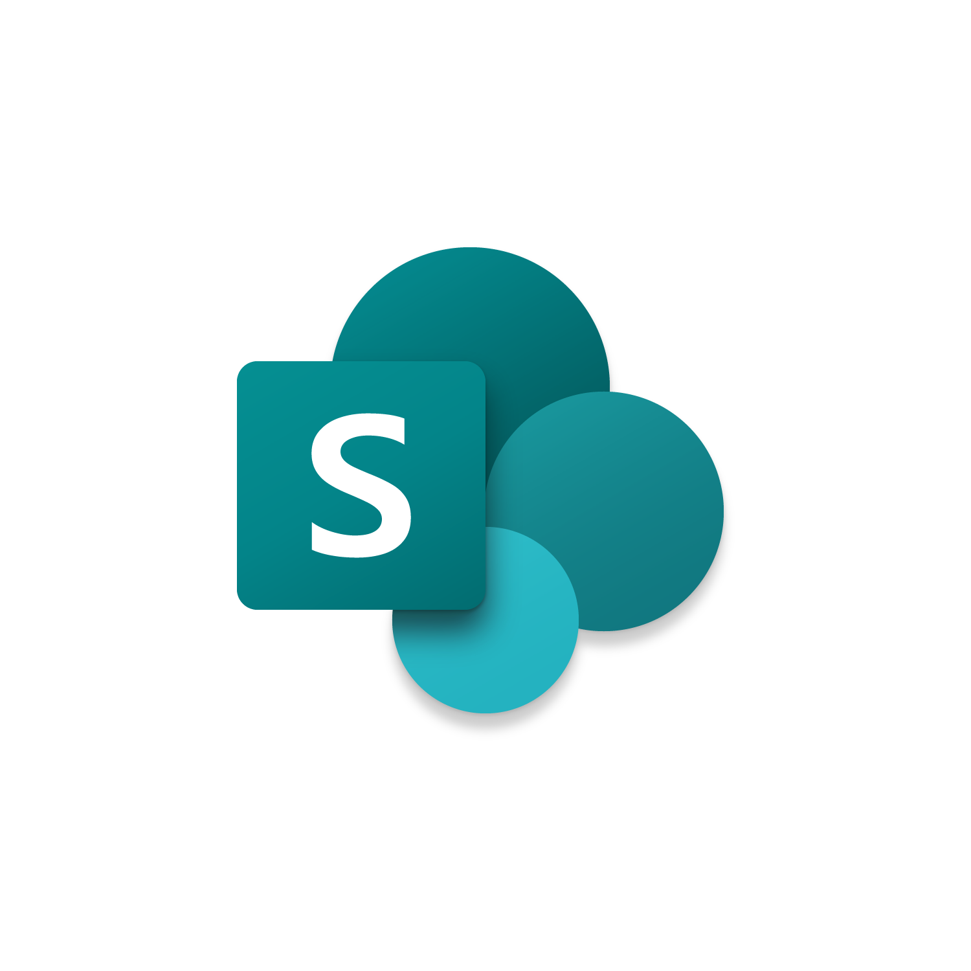



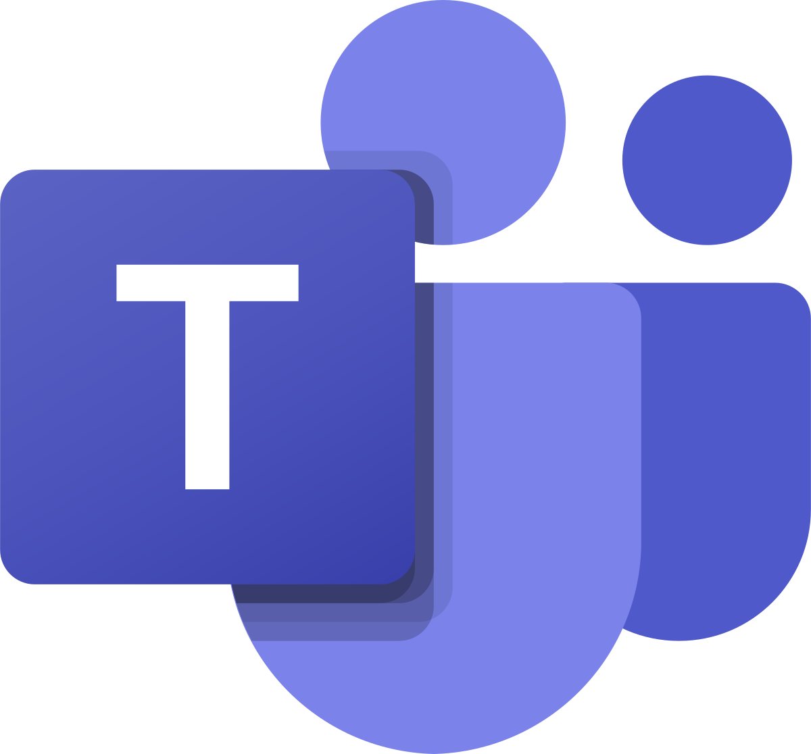

Microsoft 365 manages a wide range of everyday business processes
analyzes data
and updates a key report
triggering an approval
user
Hosted in Teams
scheduling a discussion
sending a notification
creating a to-do`
APIs via Graph
approving an update
archiving the document
Notes:
Microsoft 365 has process management – and process automation at its roots. We take for granted the processes it replaced – editing with white-out, or literally cutting and pasting documents together. And it’s actually difficult to imagine how we managed without Excel. Did the histogram/pivot tables even exist when our grandparents were at work?
So yes, a lot has changed – dramatically.
The way we communicate.
The way we store and file information
The way we search and locate knowledge.
All transformed. But transformation never stops. And the features of product like Microsoft 365 to transform business processes are conceived at scale.

Slide 4
Extend every experience where work is done
Yes
No
Maybe
Outlook
Teams
SharePoint
Windows apps


Your applications
Notes:
Our process automation tools are built with 3rd party extensibility options in mind. Be it in outlook, surfacing content through an Add-In or Sending Actionable messages, displaying content in the Windows Timeline, integrating your applications with Microsoft Graph, and so on.
Today we are here to look at how we can use these tools to enable process automation.
Microsoft 365 has a diverse offering of services and extensibility points, and we won’t cover all of them.
But we will cover several options that will enable you to accomplish more within your organization.
Lets start with Microsoft Teams, and look at collaboration within business processes.

Slide 5

Low code
Microsoft Teams
Excel
SharePoint & Power Automate
Office add-ins
Actionable messages
Pro code
Notes:
Let’s just recap. We showed you how to:
Improve collaboration in teams using a simple PowerApp
Automate and share repeatable tasks in Excel
Create workflows using SharePoint lists and PowerAutomate to keep people up-to-date no matter where they like to get work done
Then we switched to pro-code to:
Talk briefly about SharePoint as an engine for creating corporate portals, etc.
Looked at modern office add-ins and showed you Script Lab for JS developers and Adobe for end-users
And we closed with actionable messages, which are super-powerful and easy to build.

Slide 6
Implement Microsoft identity (Part 1)
Getting started with Microsoft identity platform
Register an Application

Slide 7
Overview of Microsoft identity

Slide 8
Introduction to Microsoft identity
Microsoft identity platform allows developers to build applications that sign in all Microsoft identities and get tokens to call Microsoft APIs such as Microsoft Graph, or APIs that developers have built.
Notes:
Learning Objectives:
Discuss authentication and authorization.
Describe the Microsoft identity platform.
Describe the supported identity topologies.

Slide 9
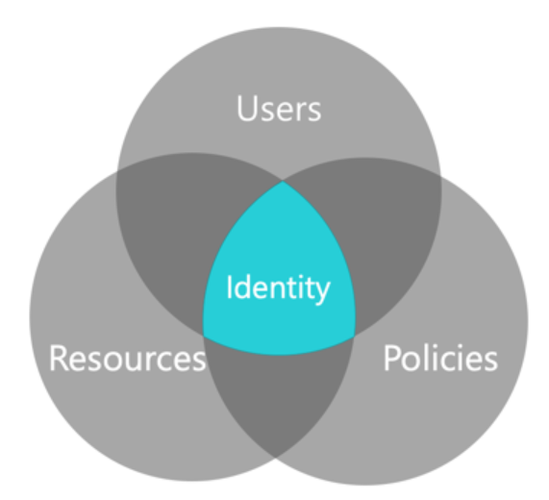
Overview of Microsoft identity
Users
Azure AD – Employees and Enterprise Resources
Azure AD B2B – Partners
Azure AD B2C – Customers/citizens
Resources
Policies

Slide 10
Overview of Microsoft identity platform
Microsoft identity platform (v. 2.0) is an evolution of the Azure Active Directory v1.0 (Azure AD) developer platform.
The Microsoft identity platform consists of:
OAuth 2.0 and OpenID Connect standard-compliant authentication service.
Open-source libraries.
Application management portal.
Application configuration API and PowerShell.
Developer content.

Slide 11
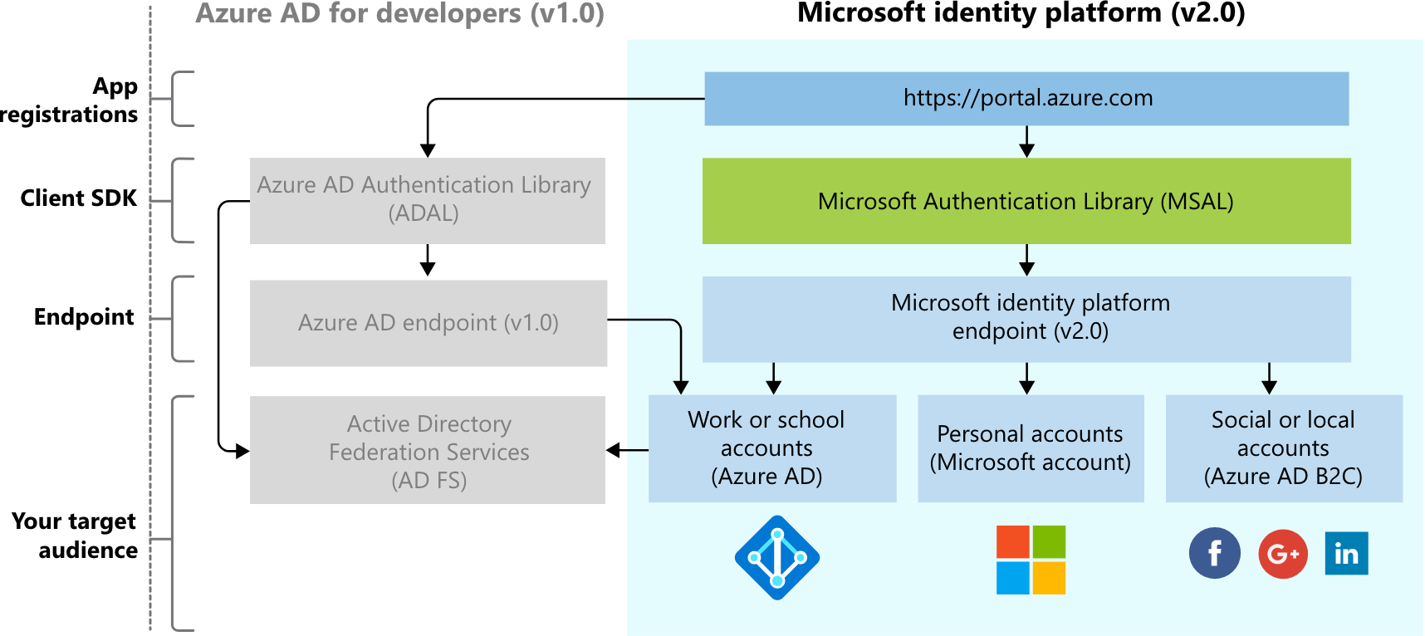
Overview of Microsoft identity platform (cont.)

Slide 12
Identity topology
Microsoft identity platform supports the following identity topologies:
Consumer
Enterprises
Business to Business (B2B)
Business to Customer (B2C)

Slide 13
Register an application

Slide 14
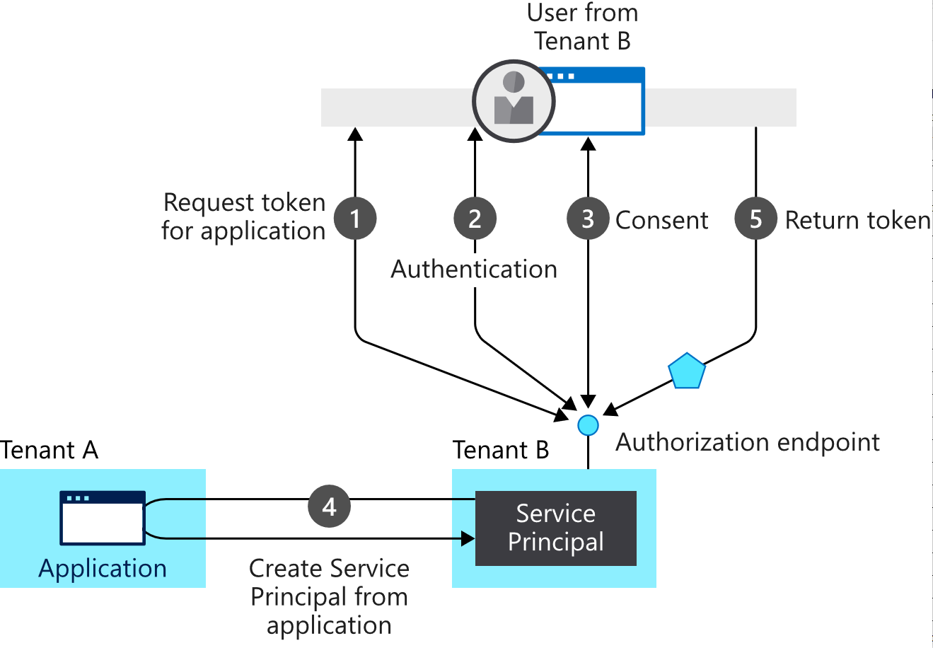
Overview of application model
Authentication
Authorization
Application object
Service principal
Consent

Slide 15
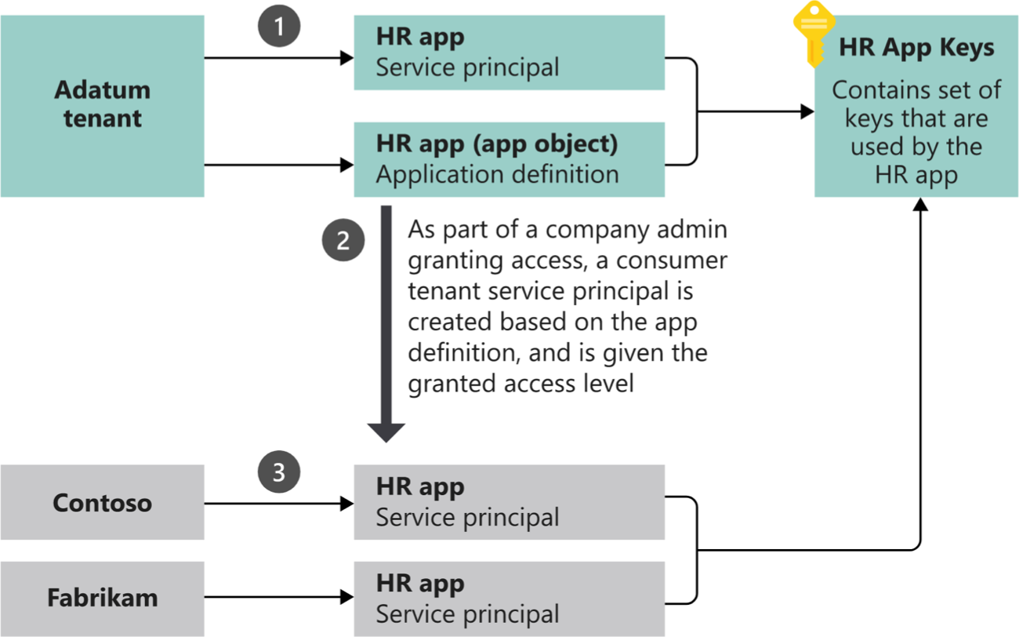
Application and service principal objects
Application object
The application properties stored in the manifest.
Defines the required application permissions.
Service principal object
A copy of the application object used in non-home tenants to define application permissions.

Slide 16
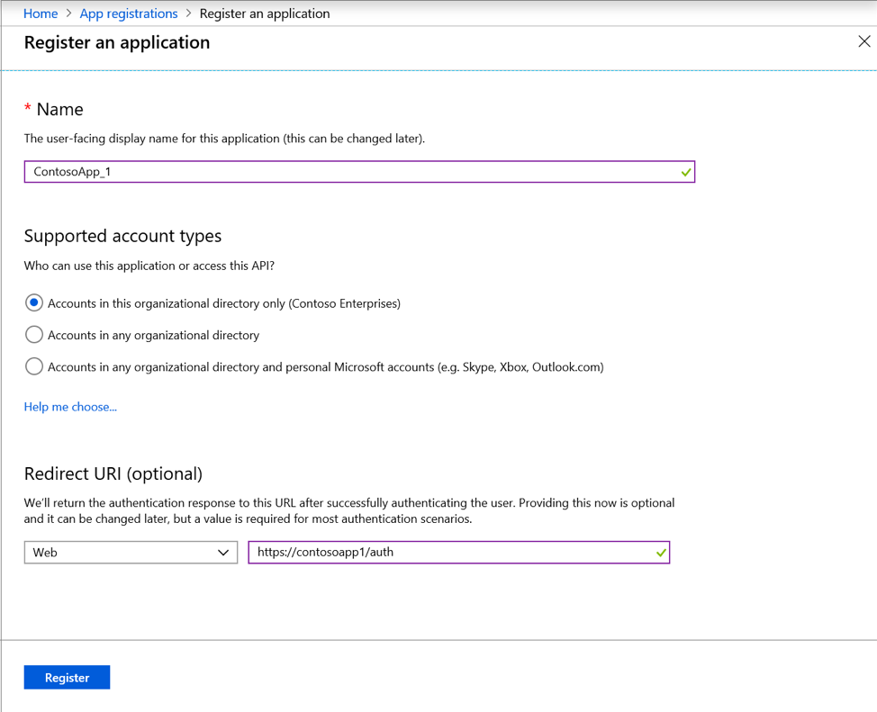
Determine the account type
Single organization
Multiple organizations
Personal Microsoft accounts

Slide 17
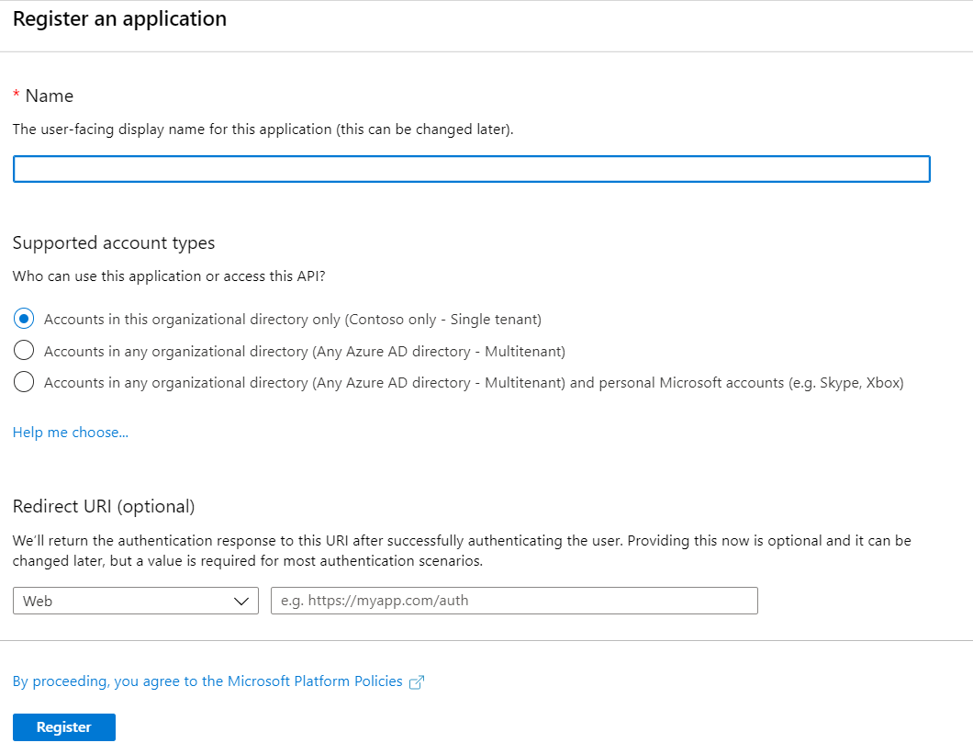
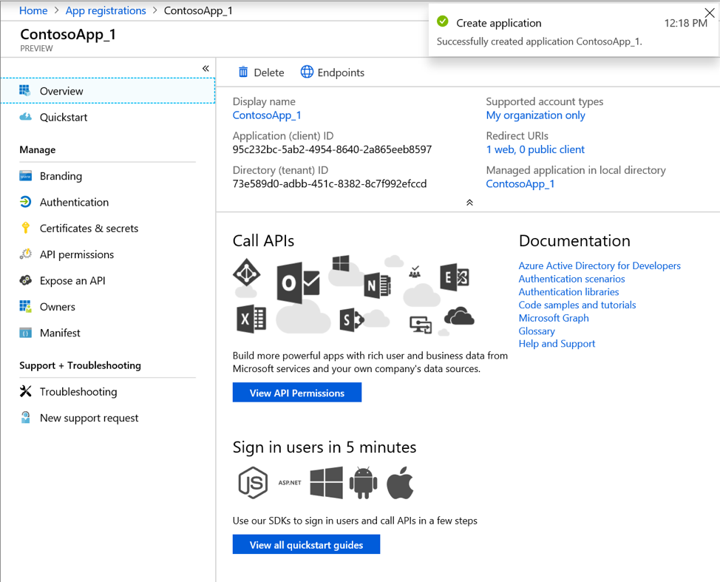
Register an application
Application name
Supported account types
Redirect URI (optional)

Slide 18
Define app roles
Application roles are used to assign permissions to users.
Azure AD App roles
Azure AD security groups
Application manager role
Notes:
Advantages, drawbacks and implementation differences for each.

Slide 19
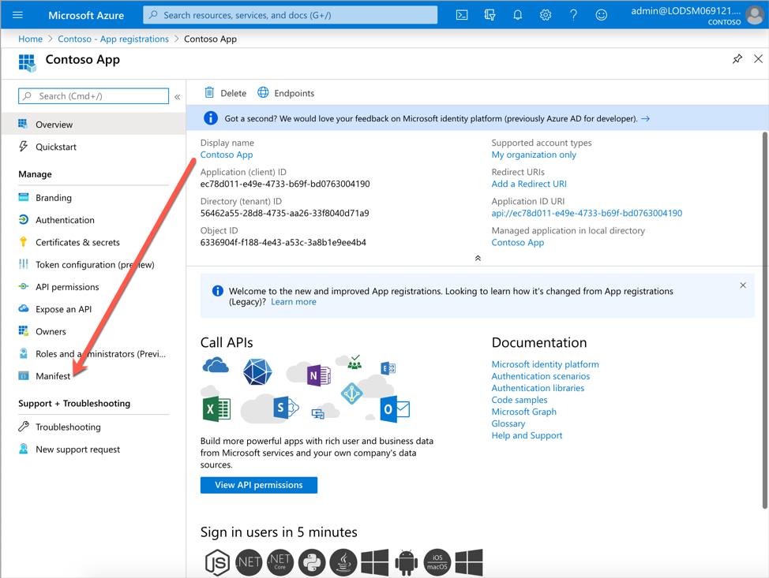
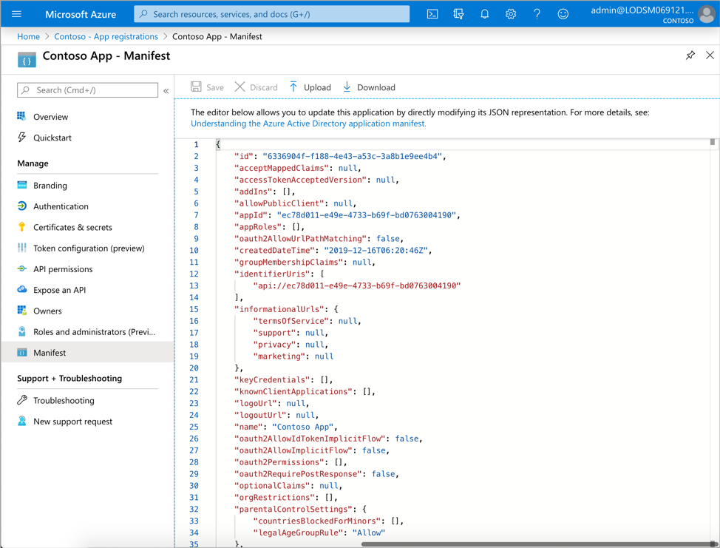
Configure Azure AD app manifest

Slide 20
Demo
Registering an application in Azure Active Directory
Notes:
Demo Resources Found here: Registering an application in Azure Active Directory
https://microsoft.sharepoint.com/:w:/t/MOCtoBaselineevents/EUsQYbuqDt1ImsQMn8hUh9kBdml-_9siCSuHVj9t6id6Ug?e=VF6v5T

